Slide 1
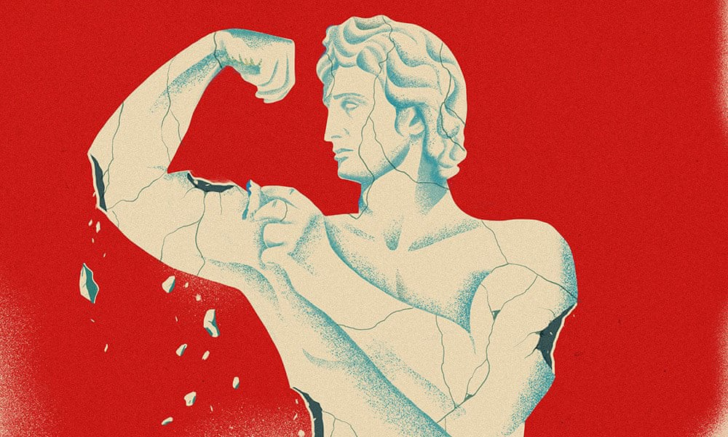
American Masculinity
The Crisis and Chaos

Slide 2

Who?
Man: An adult male human being
  A biological and immutable human characteristic
Masculinity: Qualities or attributes regarded as characteristic of men.
  A socially constructed set of behaviors associated with men and boys.
  Standards of masculinity can vary across space, place, and time.

Slide 3
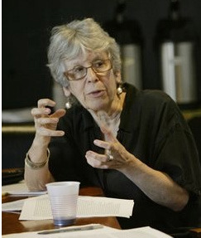
The Study of Masculinity
Joan Scott: Gender: A Useful Category of Analysis (1986)
  “Women and men [are] defined in terms of one another, and no understanding of either [can] be achieved by entirely separate study” (29).
  Her approach “insists on the need to examine gender concretely and in context and to consider it a historical phenomenon, produced, reproduced, and transformed in different situations and over time” (6).
  Scott asks readers to stop and completely reanalyze situations in history and to ask how society was organized around sexual difference and the resulting power inequalities.
  Emergent rulers (in a variety of places) have legitimized domination, strength, central authority, and ruling power as masculine (enemies, outsiders, subversives, weakness as feminine) and made that code literal in laws (forbidding women’s political participation, outlawing abortion, prohibiting wage-earning by mothers, imposing female dress codes) that put women in their place.
This analysis is a result of biological sex differences. Whether or not men (or women) want these categories assigned to them, society does so automatically based on assumptions or expectations of behavior.

Slide 4
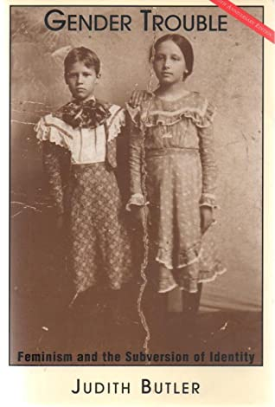
The Study of Masculinity
Judith Butler: Gender Trouble: Feminism and the Subversion of Identity (1990)
Introduces the concept of gender as a performance or gender performativity.
Relies on Foucauldian deconstruction of normativity. Foucault’s focus was mainly on homosexuality, criminality, madness. Foucault argued certain identities produce people in line with those identities and lead to what Butler would call “performativity”
Ultimately, Butler arrives at the conclusion that binary relation between men and women are just another bad disciplinary form of normativity.

Slide 5
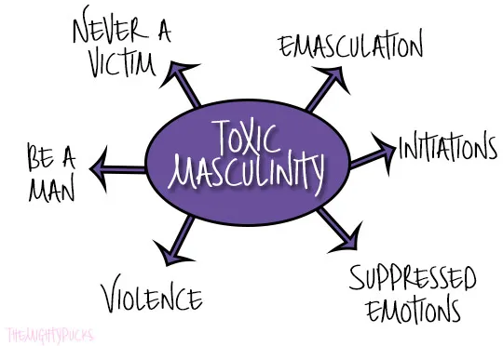
The Dark Side of Masculinity
Violence
Rape and Sexual Assault
Sexual Harassment
Male sexual misconduct as a group norm
Substance Abuse
High Risk Behavior
Absent Fathering
Homelessness and Vagrancy
Inadequate Partnering
*Question to consider: Is race a factor in this paradigm?

Slide 6
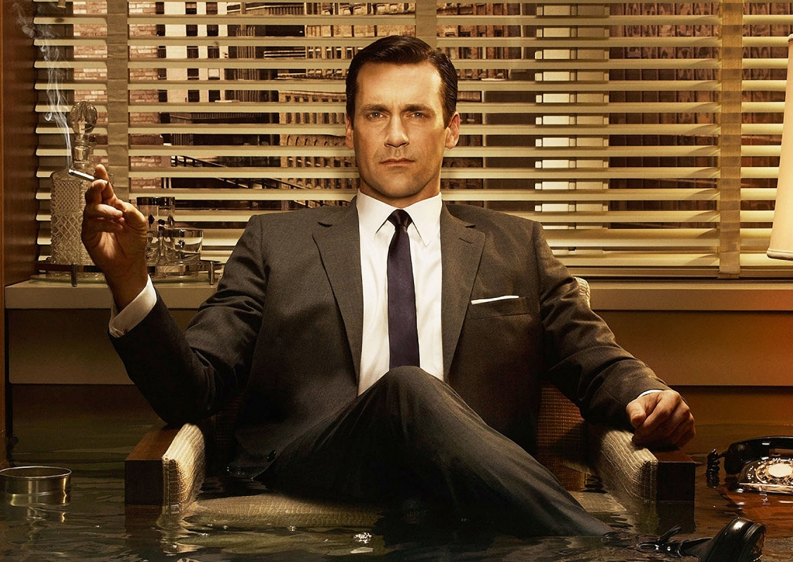
Masculine Norms Inventory
Mahalik et. al. (2003)
Winning
Emotional Control
Risk-Taking
Violence
Power over Women
Dominance
Playboy
Self-Reliance
Primacy of Work
Disdain for homosexuality
Pursuit of Status

Slide 7
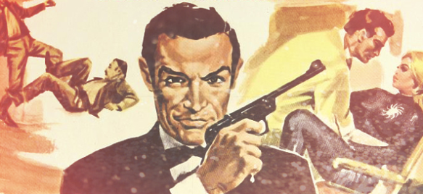
Male Roles Inventory
Levant (2010)
Avoidance of Femininity
Fear and Hatred of Homosexuality
Extreme Self-Reliance
Aggression
Dominance
Non-Relational Sexuality
Restrictive Emotionality

Slide 8
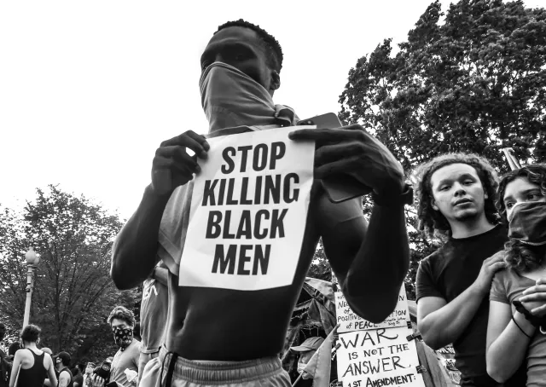
Masculine Identities & Intersectionality
SYSTEMIC ISSUES
Impact of Slavery on Black men & masculinity
  Emasculating black men through rape, torture, and exploitation of black women
  Purposely separating families
    Anger, resentment, powerlessness
Impact of systemic racism and oppression
  Unemployment
  Life Expectancy
  Incarceration
  Substance Abuse
Impact of Colonialism on masculine identity
  Introduction of gender binaries and European/Christian ideals

Slide 9
